Slide 1
Group 10 HW4 for Digital Economy & Decision Analytics
Shaoyuan Xia
Jiayi Cong
Danni Luo
Team NO.10

Slide 2
Create rotation plot for slide 17 in SVM.
Do SVM on your data of choice.

Slide 3
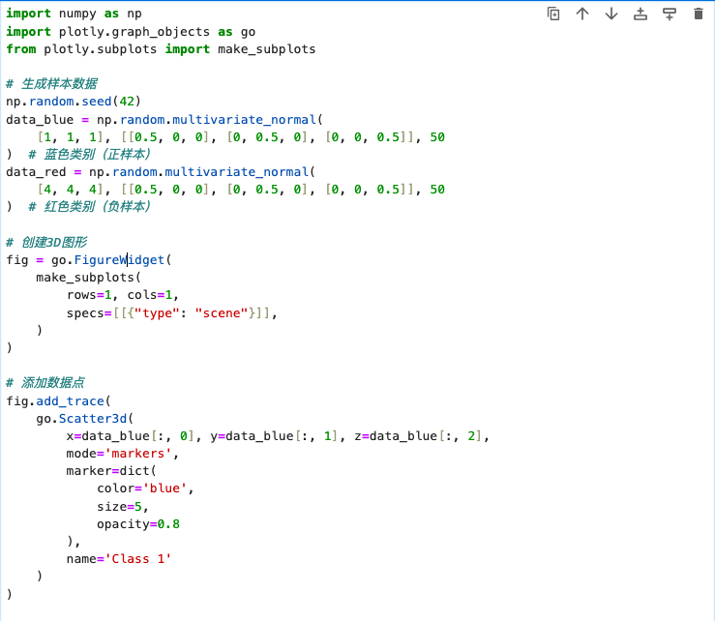
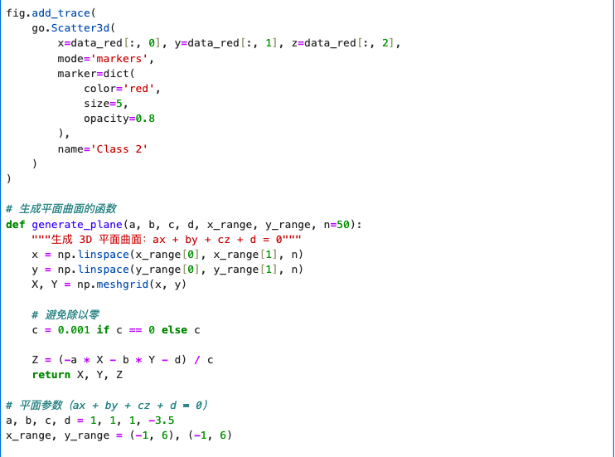
Code for a SVM rotation plot

Slide 4
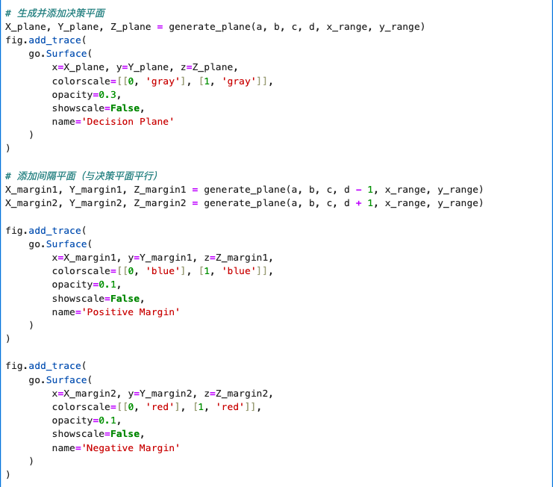
Code for a SVM rotation plot

Slide 5
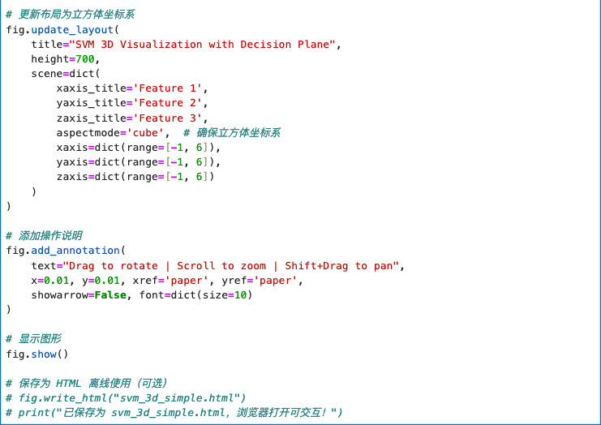
Code for a SVM rotation plot

Slide 6
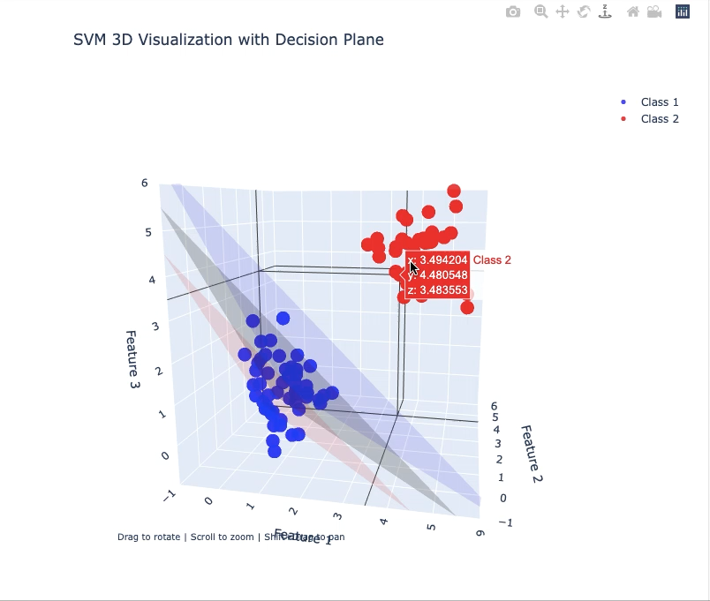
SVM 3D Visualization

Slide 7
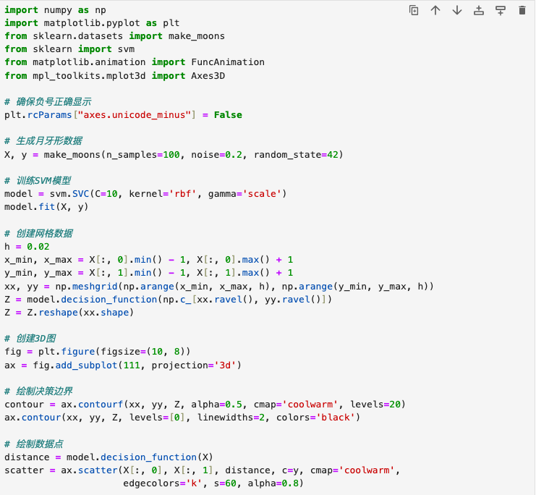
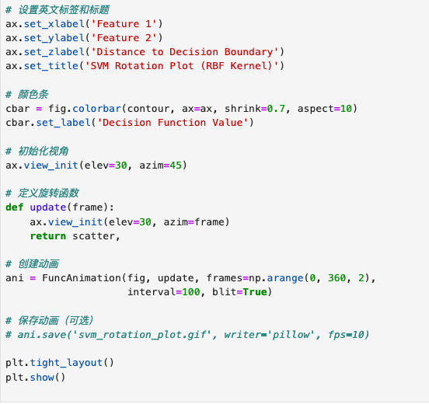
SVM Rotation Plot

Slide 8
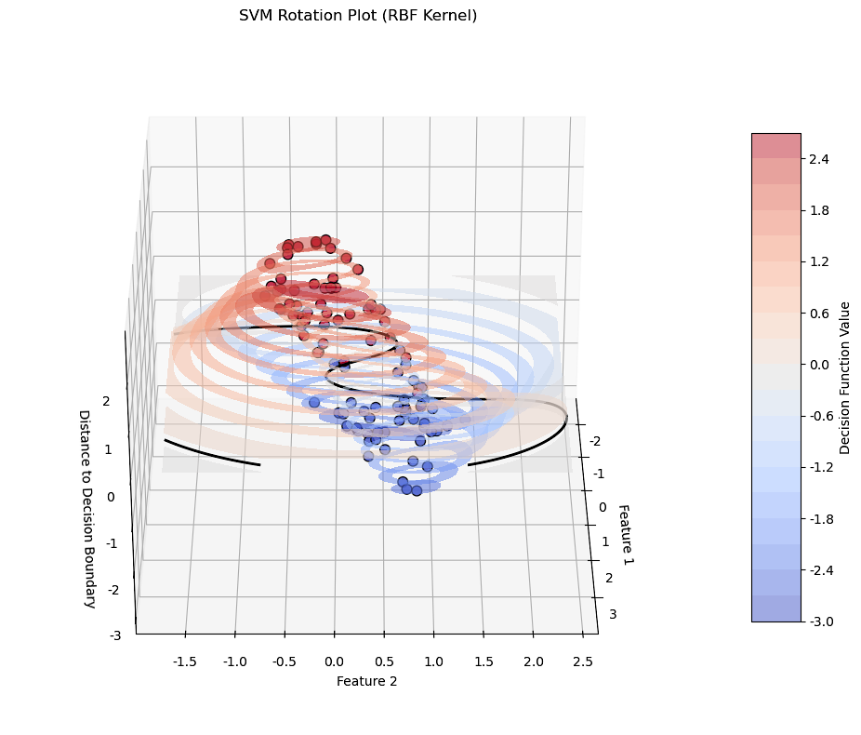
SVM Rotation Plot

Slide 9
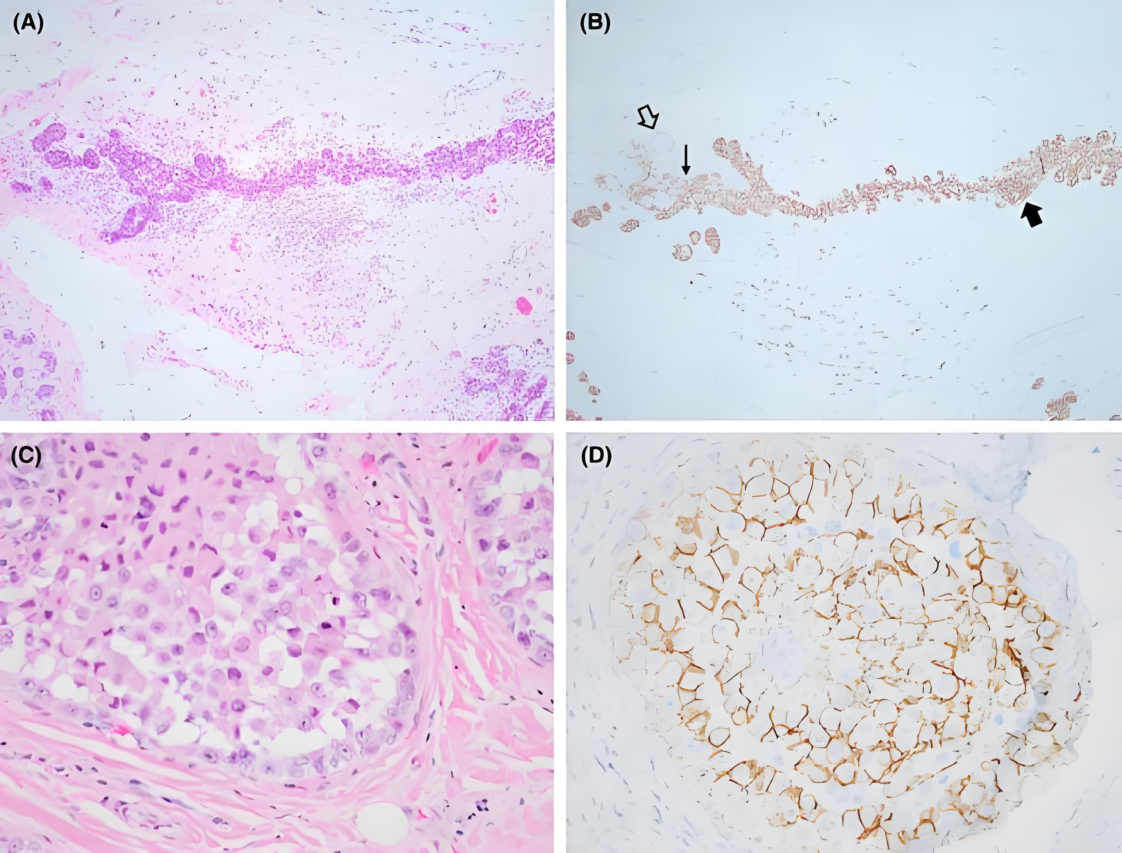
Do SVM on the diagnosis of breast cancer
Take the breast cancer diagnosis dataset as an example. Implement SVM classification using Python and combine data visualization to display the decision boundary of SVM. This dataset contains the feature data of breast tumors, with the goal of determining whether the tumor is benign (0) or malignant (1). It is a typical binary classification problem and is suitable for SVM application.

Slide 10
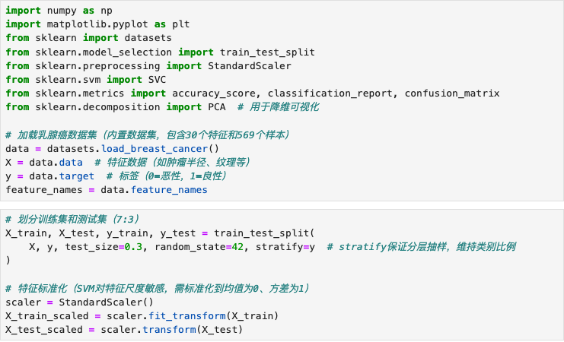
Diagnosis of breast cancer
Step 1: Import libraries and data, and perform data preprocessing

Slide 11
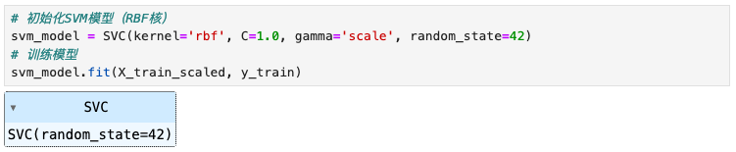
Diagnosis of breast cancer
Step 2: Train the SVM model
Select the RBF kernel function (suitable for nonlinear classification, refer to the "Kernel Techniques" section in the PPT), and control the regularization strength through the parameter C (to balance the size of the margin and the classification error):
・kernel='rbf': Radial Basis Function kernel, maps the data to a high-dimensional space to solve nonlinear classification problems (corresponding to "Kernel Technique" in the PPT);
・C=1.0: Regularization parameter, the larger C is, the heavier the penalty for classification errors of the training set (may lead to overfitting);
・gamma: Bandwidth parameter of the RBF kernel, controls the influence of a single sample on the decision boundary.

Slide 12
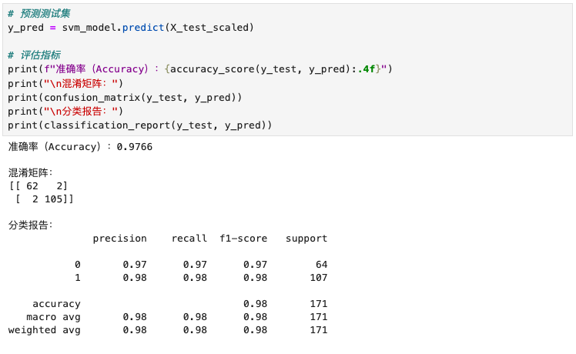
Diagnosis of breast cancer
Step 3: Model evaluation
The accuracy rate is 97.66%, indicating that SVM performs exceptionally well on this dataset;
The confusion matrix shows that only 3 cases of malignant tumors were misdiagnosed as benign, and 1 case of benign was misdiagnosed as malignant, which meets the requirements for high sensitivity (recall) in medical diagnosis.

Slide 13
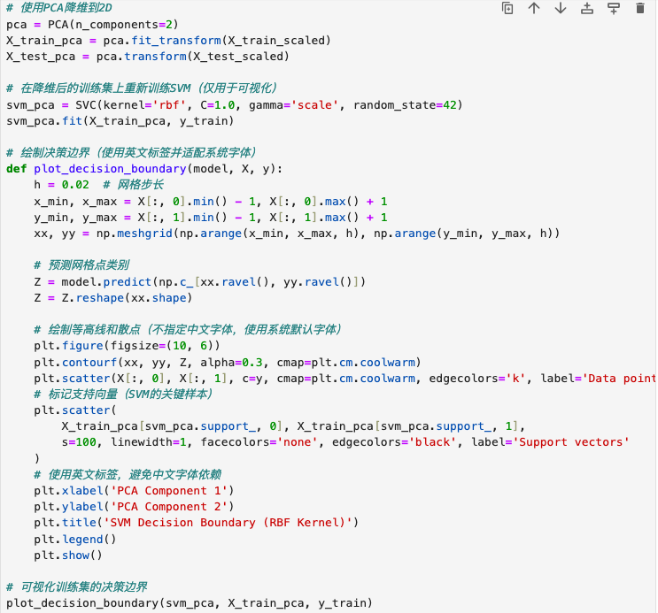
Diagnosis of breast cancer
Step 4: Visualized decision boundary (after dimensionality reduction)
Since the original data is 30-dimensional, it needs to be reduced to 2D through PCA for visualizing the decision boundary (refer to the "Visualization of High-Dimensional Data" idea in the slide)：

Slide 14
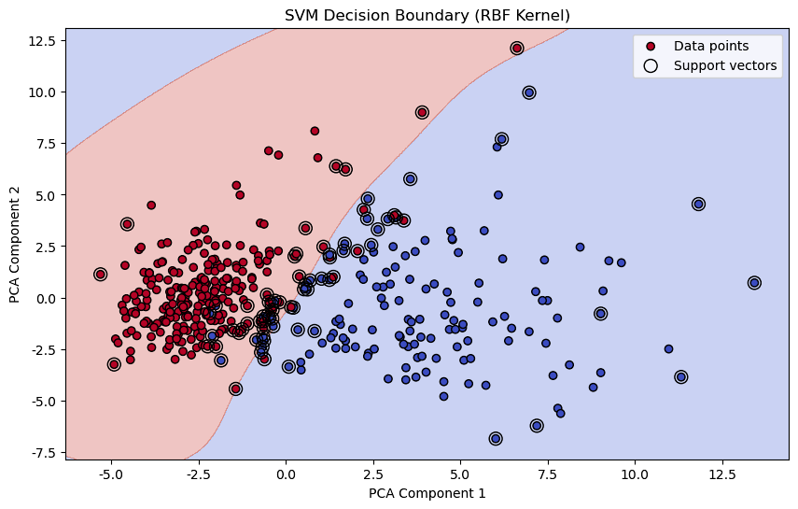
Diagnosis of breast cancer
Step 4: Visualized decision boundary (after dimensionality reduction)

Slide 15
Diagnosis of breast cancer
Step 4: Visualized decision boundary (after dimensionality reduction)
The colored areas represent the decision boundary, and different colors indicate the predicted categories of the model (benign / malignant);
The support vectors are located near the margin boundary and are the core parameters of the SVM model, determining the shape of the decision boundary.
The black hollow points are the support vectors.

Slide 16
Diagnosis of breast cancer
Summary
The core idea of SVM: Classification is achieved by finding the maximum margin hyperplane. The support vectors are the key samples that determine the hyperplane.
Kernel technique: Using the RBF kernel to map high-dimensional nonlinear data to a higher-dimensional space, converting the problem into a linearly separable one.
Parameter influence: C controls the balance between margin and error, and gamma affects the complexity of the RBF kernel, which needs to be optimized through parameter tuning.

